Slide 1
CS61C: Great Ideas in Computer Architecture (aka Machine Structures)
Lecture 27: Concurrency
Instructors: Dan Garcia, Justin Yokota

Slide 2
Agenda
Race Conditions
Locks and critical segments

Slide 3
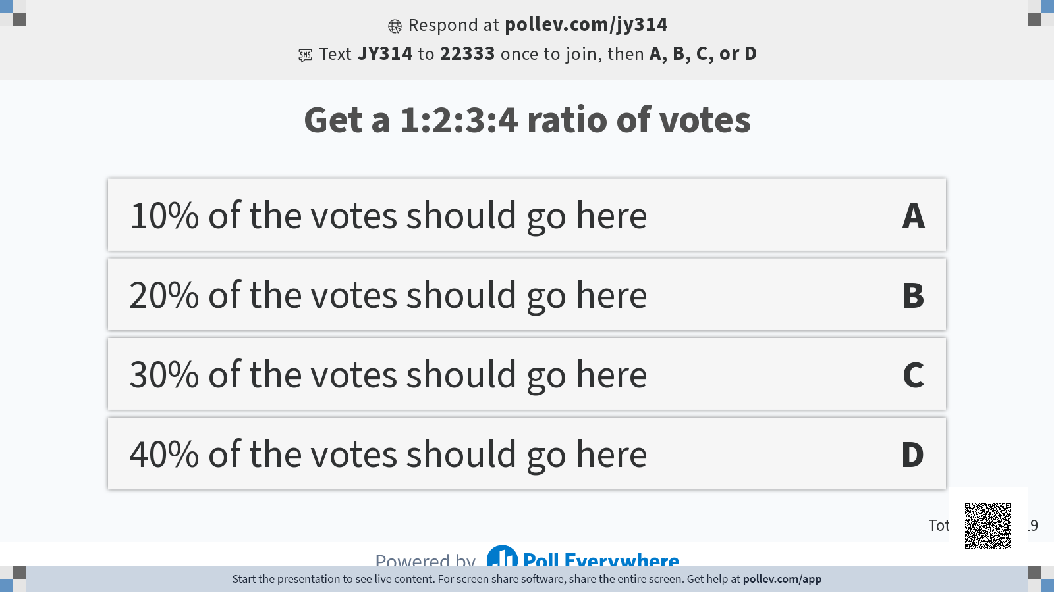

Slide 4
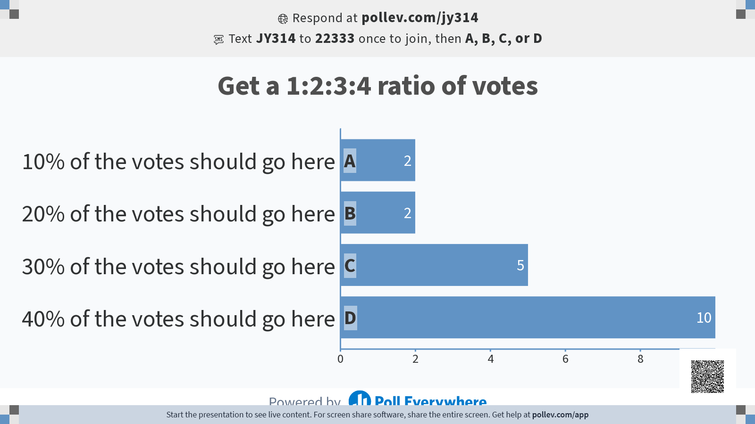

Slide 5
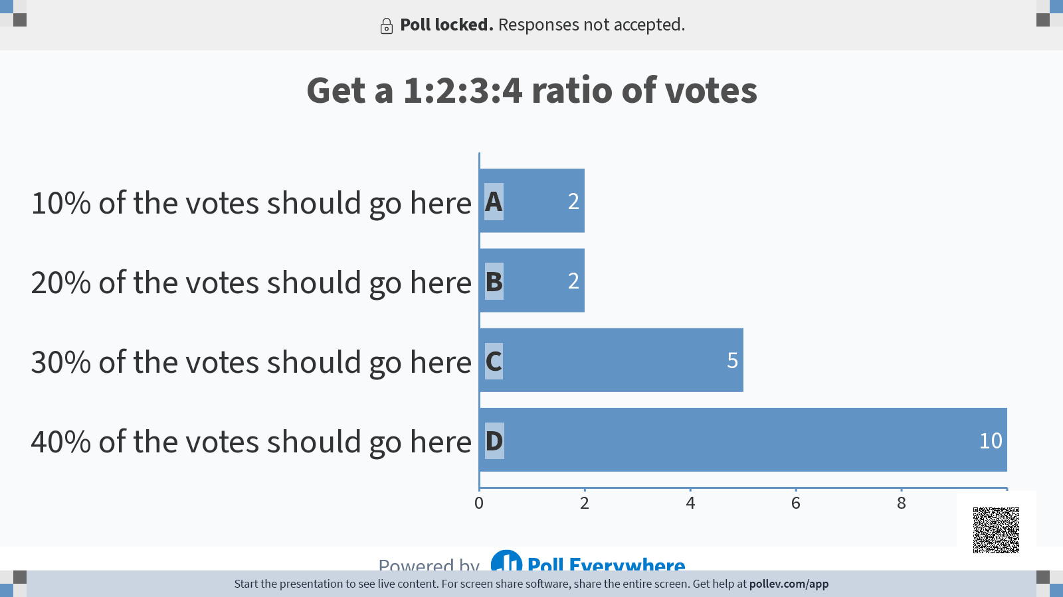

Slide 6
Data Races/Race Conditions
Note that when we ran Hello World parallel, we ended up with the threads running in random order
In fact, every time we run Hello World, we get a different order!
The x values stayed largely in-order, but didn't always strictly increase
Recall the OS can choose whichever threads it wants to run, and change threads at any time
This is one of the biggest downsides to multithreading: A multithreaded program is no longer deterministic, and will have a random execution order every time we run the program.
Formally, a multithreaded program is only considered correct if ANY interlacing of threads yield the same result.

Slide 7
Data Race: Example
If we run this code on 4 threads, what possible values could x be at the end?
int x = 0; #pragma omp parallel { x = x + 1; }

Slide 8
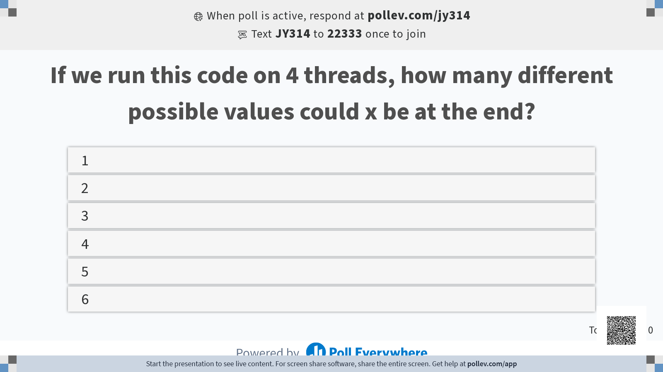

Slide 9
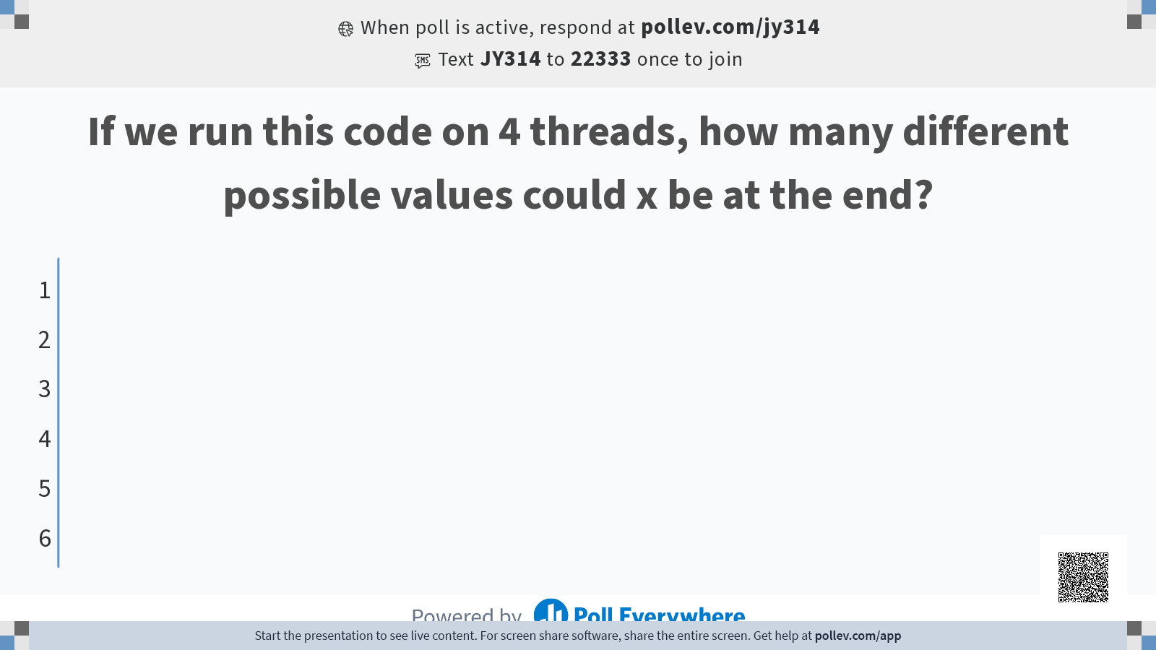

Slide 10
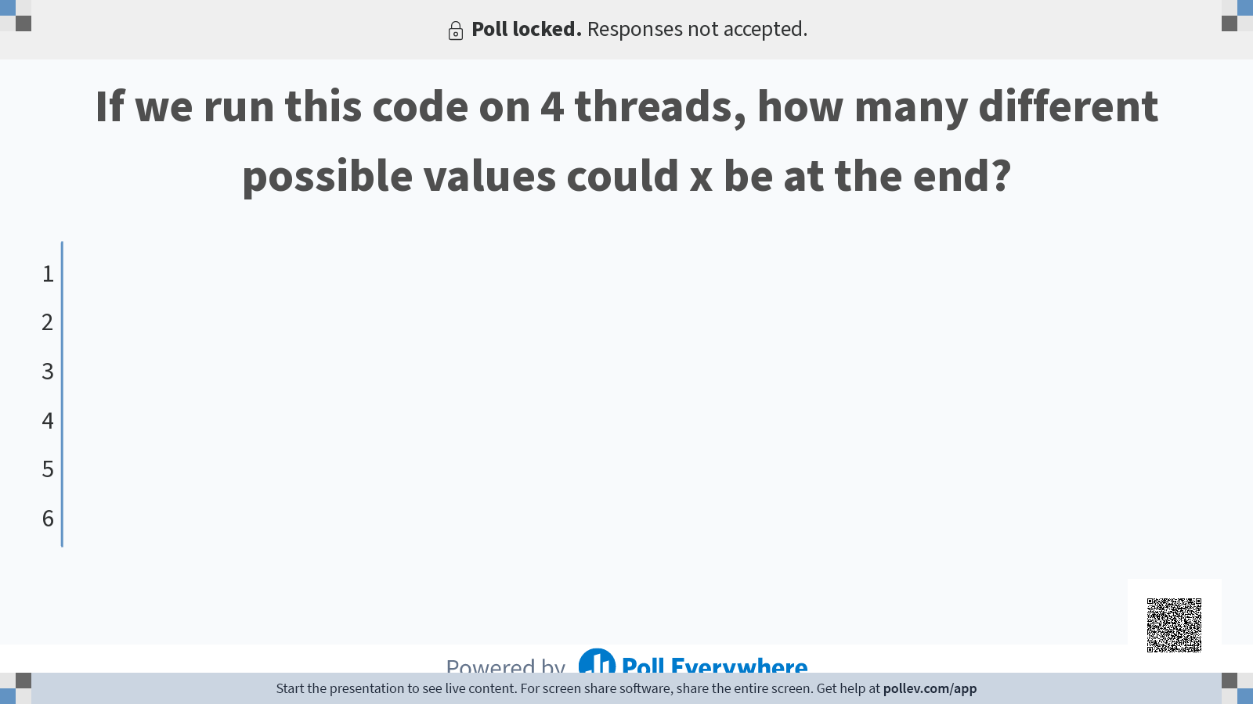

Slide 11
Data Race: Example
To analyze this, we need to see the equivalent assembly code
C will compile to x86, but we can still do a correct analysis by compiling to RISC-V, since we're mainly trying to reduce the code to atomic instructions. We can assume that no two atomic instructions happen simultaneously.
Only the loads and stores affect shared memory, so we only need to consider the different ways we can order the loads and stores
Even with this, there are 8!/(2!)⁴=2520 different possible orders
Can use the fact that all the threads are identical to reduce this to 105 orders, but still too many to check manually
lw t0 0(sp) addi t0 t0 1 sw t0 0(sp)
lw t0 0(sp) addi t0 t0 1 sw t0 0(sp)
sw x0 0(sp)
lw t0 0(sp) addi t0 t0 1 sw t0 0(sp)
lw t0 0(sp) addi t0 t0 1 sw t0 0(sp)

Slide 12
Data Race: Example
Case 1: All the threads run one at a time
Purple thread reads x = 0
Purple thread stores x = 1
Brown thread reads x = 1
Brown thread stores x = 2
Red thread reads x = 2
Red thread stores x = 3
Blue thread reads x = 3
Blue thread stores x = 4
Final value: 4
sw x0 0(sp) lw t0 0(sp) addi t0 t0 1 sw t0 0(sp) lw t0 0(sp) addi t0 t0 1 sw t0 0(sp) lw t0 0(sp) addi t0 t0 1 sw t0 0(sp) lw t0 0(sp) addi t0 t0 1 sw t0 0(sp)

Slide 13
Data Race: Example
Case 2: The threads are perfectly interleaved
Purple thread reads x = 0
Red thread reads x = 0
Brown thread reads x = 0
Blue thread reads x = 0
Purple thread stores x = 1
Brown thread stores x = 1
Red thread stores x = 1
Blue thread stores x = 1
Final value: 1
sw x0 0(sp) lw t0 0(sp) lw t0 0(sp) lw t0 0(sp) lw t0 0(sp) addi t0 t0 1 addi t0 t0 1 addi t0 t0 1 addi t0 t0 1 sw t0 0(sp) sw t0 0(sp) sw t0 0(sp) sw t0 0(sp)

Slide 14
Data Race: Example
Case 3: Same as case 1, except purple's store happens last
Purple thread reads x = 0
Brown thread reads x = 0
Brown thread stores x = 1
Red thread reads x = 1
Red thread stores x = 2
Blue thread reads x = 2
Blue thread stores x = 3
Purple thread stores x = 1
Final value: 1
sw x0 0(sp) lw t0 0(sp) addi t0 t0 1 lw t0 0(sp) addi t0 t0 1 sw t0 0(sp) lw t0 0(sp) addi t0 t0 1 sw t0 0(sp) lw t0 0(sp) addi t0 t0 1 sw t0 0(sp) sw t0 0(sp)

Slide 15
Data Race: Example
Some other ordering?
We can find orderings that give x=2,3
Can we do any more/less?
Can't go above 4
Only 4 "+1s" overall, so can't increase to 5 or more
Can't go below 1
The smallest value that can be loaded by a thread is 0, so the smallest value that can be stored is 1. Therefore, the last store must be at least 1.
Therefore, we can get any value between 1 and 4
sw x0 0(sp) lw t0 0(sp) lw t0 0(sp) lw t0 0(sp) addi t0 t0 1 addi t0 t0 1 addi t0 t0 1 sw t0 0(sp) lw t0 0(sp) addi t0 t0 1 sw t0 0(sp) sw t0 0(sp) sw t0 0(sp)
sw x0 0(sp) lw t0 0(sp) lw t0 0(sp) addi t0 t0 1 addi t0 t0 1 sw t0 0(sp) lw t0 0(sp) addi t0 t0 1 sw t0 0(sp) lw t0 0(sp) addi t0 t0 1 sw t0 0(sp) sw t0 0(sp)

Slide 16
Data Race Example: Retrospective
In practice, most times you run this code, you get 4
Each thread is small enough that it's unlikely to get interrupted
Empirical tests suggest an error rate around 0.01%.
In summation, race condition bugs are:
Rare
Nondeterministic
Silent-failing (you get the wrong answer instead of crashing the program)
Very difficult to debug. You have been warned…

Slide 17
Avoiding Data Races
Formally, a multithreaded program is only considered correct if ANY interlacing of threads yield the same result.
If you make sure that each thread works on independent data (no two threads write to the same value, or read a value that another thread wrote to), you can guarantee correctness
The hardest part of multithreading is maintaining correctness while also speeding up the code, but this ends up being a fairly transferable skill to management
If you can coordinate a group of threads to perform a task, you can coordinate a group of people to perform a task more easily.
How to handle cases where coordination is mandatory?

Slide 18
Resolving Data Races: Buying Milk
Alice and Bob want to buy milk. How do they do this without communicating?
Assumption: Must decide procedure beforehand
Assumption: Both people get the same instructions (though we can refer to one person with names)

Slide 19
Buying Milk: Attempt 1
If milk not in fridge:
Go to store and buy milk
Put milk in fridge

Slide 20
Buying Milk: Problem with Attempt 1
If milk not in fridge: #No milk in fridge, so True
If milk not in fridge: #No milk in fridge, so True
Go to store and buy milk #Bob bought milk
Go to store and buy milk #Alice bought milk
Put milk in fridge #1 milk in fridge
Put milk in fridge #2 milks in fridge
Maybe we should have put a note on the fridge…

Slide 21
Buying Milk: Attempt 2
If note not on fridge:
If milk not in fridge:
Put note on fridge
Go to store and buy milk
Put milk in fridge
Take note off fridge

Slide 22
Buying Milk: Problem with Attempt 2
If note not on fridge: #No note on fridge
If milk not in fridge: #No milk in fridge
If note not on fridge: #No note on fridge
Put note on fridge #Now there's a note on the fridge…
If milk not in fridge: #Still no milk in fridge
Put note on fridge #Two notes on fridge
Go to store and buy milk
Put milk in fridge #1 milk in fridge
Take note off fridge #1 note on fridge
Go to store and buy milk
Put milk in fridge #2 milks in fridge
Take note off fridge #0 notes on fridge

Slide 23
Buying Milk: Attempt 3
If note not on fridge:
If milk not in fridge:
Put note on fridge
If two notes on fridge:
goto End
Go to store and buy milk
Put milk in fridge
End: Take note off fridge

Slide 24
Buying Milk: Problem with Attempt 3
If note not on fridge: #No note on fridge
If note not on fridge: #No note on fridge
If milk not in fridge: #No milk in fridge
If milk not in fridge: #No milk in fridge
Put note on fridge #One note on fridge
Put note on fridge #Two notes on fridge
If two notes on fridge: #Two notes on fridge
If two notes on fridge: #Two notes on fridge
goto End #Go to End
goto End #Go to End
Go to store and buy milk
Go to store and buy milk
Put milk in fridge
Put milk in fridge
End: Take note off fridge #1 note on fridge
End: Take note off fridge #0 notes on fridge, 0 milk in fridge

Slide 25
Buying Milk: Problems with all our attempts
Regardless of how we do it, this doesn't work if the instructions happen to be perfectly interleaved
Why?
Every branch will have the same result, since no instruction checks a value AND writes to a memory location at the same time.
If both people follow the same code path, we either get no milk, or two milk.
Well, there is one strategy that works

Slide 26
Buying Milk: Attempt 4
If name is Alice:
If milk not in fridge:
Go to store and buy milk
Put milk in fridge

Slide 27
Buying Milk: Problem with Attempt 4
If we give the task to Alice, that works; we'll get exactly 1 milk, guaranteed
Problem: What if Alice is really busy and can't check the fridge for a few days?
We end up getting milk later than we want to.

Slide 28
Atomic Operations
Regardless of how we do it, this doesn't work if the instructions happen to be perfectly interleaved
Why?
Every branch will have the same result, since no instruction checks a value AND writes to a memory location at the same time.
If both people follow the same code path, we either get no milk, or two milk.
Solution: Create an instruction that checks a value AND writes to a memory location at the same time.
Known as "atomic" instructions because they do two things but are indivisible.
RISC-V atomic extension example:
amoswap.w rd rs2 (rs1): rd = 0(rs1), 0(rs1) = rs2 atomically
A bit hard to use directly, but using this, we can make synchronization primitives

Slide 29
Locks
A lock is an object which helps with synchronization
Essentially, each thread can try to "acquire" a lock, but only one thread can have the lock at a given time.
Think bathroom stall lock; only one person can use the stall at a time, and we use atomics to make sure two people don't go into the same stall at the same time
Formally, has two operations
acquire: Tries to acquire the lock. If successful, keep going. Otherwise, wait a bit and try again later.
release: Unlocks the lock and continues. Only works if we had the lock to start with.
Optional but common: try-acquire: Same as acquire, but if the lock is being used, return false and let the thread continue running
Code surrounded by a lock is called a "critical section", because only one thread is allowed to run that section at a time.

Slide 30
Buying Milk: Attempt 5
Acquire fridgelock
If milk not in fridge:
Go to store and buy milk
Put milk in fridge
Release fridgelock

Slide 31
Buying Milk: Attempt 5
Acquire fridgelock #Alice has the lock
Acquire fridgelock #Bob can't get the lock, so needs to wait
If milk not in fridge: #No milk in fridge
Go to store and buy milk
Put milk in fridge #1 milk in fridge
Release fridgelock #Alice releases lock. Bob can now get the lock
If milk not in fridge: #1 milk in fridge
Go to store and buy milk
Put milk in fridge
Release fridgelock #Bob releases lock

Slide 32
Locks: Downsides
Using a lock inherently means you need to pause one thread while waiting for another thread to run the critical segment
Ends up making some parts of your code serial
Amdahl's Law strikes again!
Is it possible for all threads to get stuck?

Slide 33
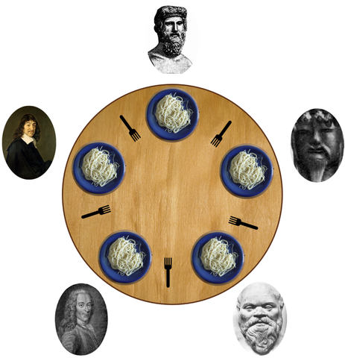
Thought Experiment: The Dining Philosophers Problem
Five pre-COVID philosophers are sitting at a table eating spaghetti
The philosophers will alternate between eating and thinking
Between each philosopher is one chopstick
To eat spaghetti, a philosopher must pick up two chopsticks (the one immediately to their left, and the one immediately to their right). A philosopher will take a bite of spaghetti, put the chopsticks back down, and resume thinking.
Philosophers can't speak or coordinate
Goal: prevent the philosophers from starving
Notes:
Image Source: https://upload.wikimedia.org/wikipedia/commons/7/7b/An_illustration_of_the_dining_philosophers_problem.png

Slide 34
The Dining Philosophers Problem: Naive Solution
While True: Acquire left chopstick; think until it's available Acquire right chopstick; think until it's available Take a bite of spaghetti Put down left chopstick Put down right chopstick
Notes:
Image Source: https://upload.wikimedia.org/wikipedia/commons/7/7b/An_illustration_of_the_dining_philosophers_problem.png

Slide 35
The Dining Philosophers Problem: Naive Solution Problem
What happens?
Imagine all philosophers grab the left chopstick at the same time
All the philosophers wait for the right chopstick to be available, and get stuck thinking forever
The five philosophers starve to death waiting for chopsticks
This is known as a deadlock; if this happens in your program, every thread gets stuck waiting for some other thread to finish work, so the program freezes.
Notes:
Image Source: https://upload.wikimedia.org/wikipedia/commons/7/7b/An_illustration_of_the_dining_philosophers_problem.png

Slide 36
The Dining Philosophers Problem: Resolutions
An active topic in concurrency programming
Several common solutions; goal is to get rid of the symmetry of the problem:
Only let four philosophers in to the dining room at any given time
Have a "manager" that assigns both chopsticks at once
Choose one philosopher to pick up the right chopstick first before the left chopstick
Notes:
Image Source: https://upload.wikimedia.org/wikipedia/commons/7/7b/An_illustration_of_the_dining_philosophers_problem.png

Slide 37
Critical sections
Fortunately, OpenMP gives you some commands that let you use critical segments completely safely
#pragma omp barrier
Forces all threads to wait until all threads have hit the barrier
#pragma omp critical
Creates a critical segment in parallel code; only one thread can run a critical segment at a time.
Using these guarantees you avoid deadlocks, so we'll recommend using these exclusively in this class.
Locks get used significantly more in CS 162 (Operating Systems)

Slide 38
Parallel Hello World with Critical Segments
#include <stdio.h> #include <omp.h> int main () { int x = 0; //Shared variable #pragma omp parallel { int tid = omp_get_thread_num(); //Private variable #pragma omp critical { x++; printf("Hello World from thread %d, x = %d\n", tid, x); } #pragma omp barrier if(tid==0) { printf("Number of threads = %d\n", omp_get_num_threads()); } } printf("Done with parallel segment\n"); }

